Slide 1
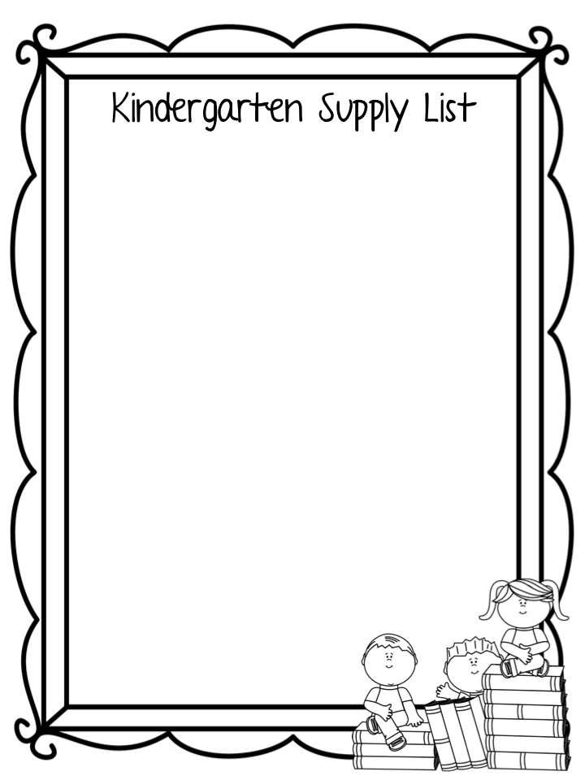
1- Box Crayola Colored Pencils
1- Package of Sidewalk Chalk
1- Package of google eyes
2- Rolls of Paper Towels
6- Boxes (not round) baby wipes
3- Containers of Clorox wipes
1- Bottle of bubble refill
1- Box of Bandaids
4- Elmer’s Glue Sticks
1- Can of Lysol Spray
2- Boxes of Tissues
1- Crayola Washable Markers Classic Colors
1- Bottle of hand sanitizer

Slide 2
1- Ream of copy paper
2- Crayola Washable Markers Classic Colors
1- 24 count Crayola Crayons
4- 4 oz. Elmer's School Glue, white
1- Box Bandaids
2- Packs of Elmers glue sticks – large size
1- Box gallon size Ziploc bags
1- Box Kleenex tissues
2- Containers of baby wipes
1- Ream of white copy paper
2- Containers Clorox wipes
2- Rolls of Paper Towels
1- Composition Book
1- 1½ inch 3 ring binder
1- 5" blunt Fiskars Scissors
1- Box of envelopes, any size
1- 2 pocket folder, no brads

Slide 3
7 - Jumbo Crayola Crayons 8 or 16 count
4- Crayola Washable Markers Classic Colors
4- Crayola Washable Markers Bold Colors
20- Jumbo Ticonderoga beginner Pencils with erasers
3- 5" blunt Fiskars Scissors
10- Jumbo glue sticks
3- Boxes Kleenex tissues
4- Containers Clorox wipes
4- Containers Wet Ones hand wipes
1- Box Ziploc Quart size bags
1- Box Ziploc Gallon size bags
1- Ream of Copy paper
1- Box of bandaids
1- Coloring /activity book
2- Rolls of paper towels
1- Roll Clear contact paper to cover workbooks

Slide 4
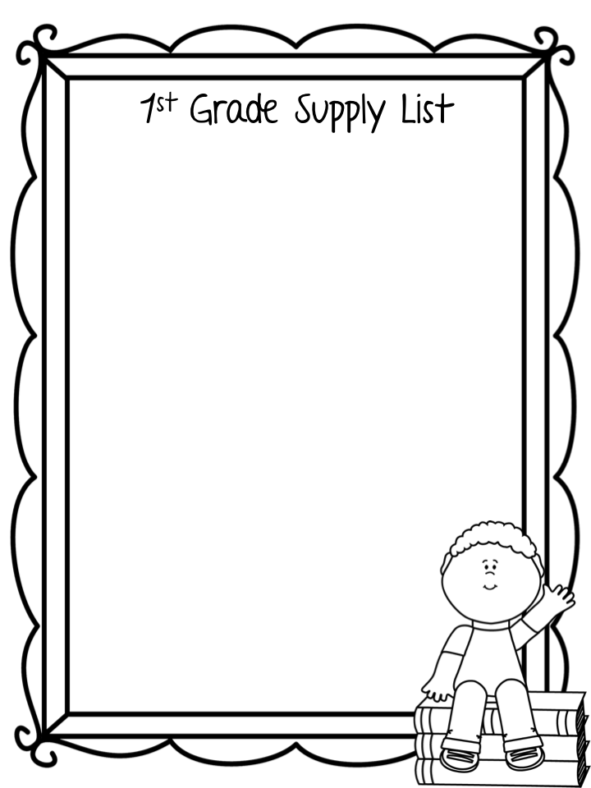
12- Ticonderoga My First Tri-write Pencils
4- Staedtler White Plastic erasers with holder (found at Staples)
1- 5" blunt Fiskars Scissors
2- Jumbo Crayola Crayons 8 or 16 count
2- Boxes of Kleenex tissues
2- Containers Wet Ones hand wipes
2- Containers of Lysol Disinfecting Wipes
1- 4 oz. Elmer's Washable glue, white
6- Large Elmer’s glue sticks Clear.77oz.
3- 2 pocket plastic folders (any color)
1- Coloring/activity book
2- Rolls Clear contact paper to cover workbooks
1- bottle of hand sanitizer
*Please write your child's name on his/her possessions with permanent marker

Slide 5
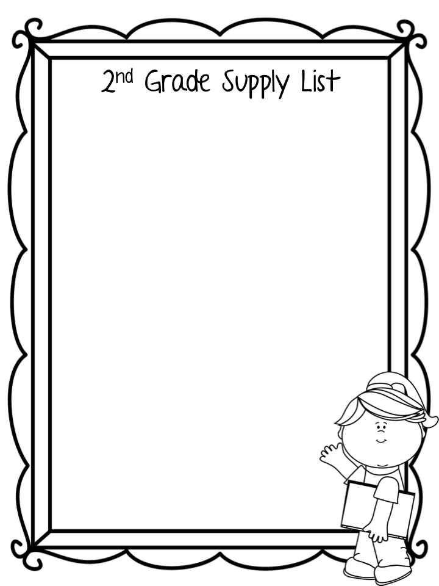
3- Boxes Crayola colored pencils
2- 24 count Crayola crayons
1- 8 count Crayola Original Formula Markers
5- Packs of Sharpened No. 2 pencils
2- Handheld Pencil sharpeners double barrel cannister
4- Packs of erasers (large pink)
2- 4 oz. Elmer's washable school glue, white
2- Elmer’s glue sticks
2- 5" blunt Fiskars Scissors
2- Plastic pocket folder with clasps
1- Ream of white copy paper
1- Handwriting Composition Book-Gr. 2
2- Container of Clorox wipes
2- Containers Wet Ones hand wipes
2- boxes Kleenex tissues
2- set of headphones
1- set of Rosary Beads
1- Roll Clear contact paper to cover
workbooks

Slide 6
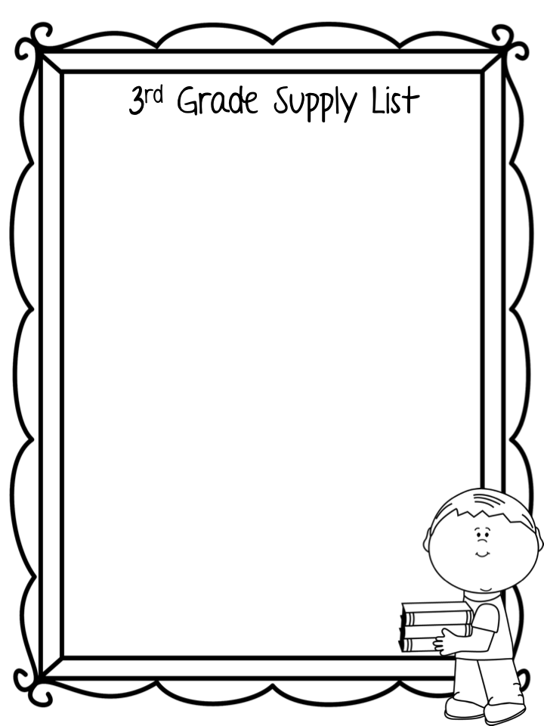
4- Plastic pocket folders with clasps
2- Boxes of twelve sharpened No. 2 pencils
2- Handheld Pencil sharpeners double barrel cannister
1- Box of Crayola Crayons
1- Box Crayola colored pencils
1- Crayola Washable Markers Classic Colors
6- Marble Composition books
1- 5" blunt Fiskars Scissors
2- Boxes Kleenex tissues
3- Containers Clorox wipes
2- Containers Wet Ones hand wipes
6- Elmer's Glue Sticks
1- Ruler (inches and centimeters)
1- Large nylon zipper pencil pouch
1- Ream of white copy paper
1- Set of headphones
1- Set of Rosary Beads
1- Binder- 1 inch

Slide 7
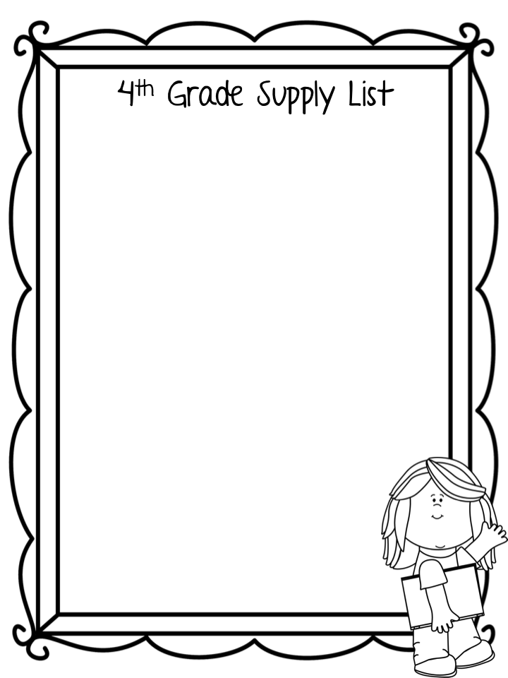
1- Wooden 12" ruler (standard + metric)
2- Handheld Pencil sharpeners
4- Red pens
2- Large pink erasers
2- Boxes Kleenex tissues
1- Marble Composition books
2- Filler paper WM 150 count
1- 5 " pointed Fiskars Scissors
1- Large Pencil Bag
1- Box Crayola colored pencils
1- Graph paper notebook
1- Ream of copy paper
3- Packs of Sharpened No. 2 pencils
1- Large Elmer's washable glue stick
1- Plastic pocket folders with clasps
1- Pack of different color highlighters
1- Expanding file docket with at least 7 pockets
1- Pack of skinny Expo markers
1- Expo eraser or cloth
1- Pocket dictionary (student)
1- Pocket thesarus (student)
1- Bottle of Hand Sanitizer
2- Containers Clorox wipes
1- Set of headphones
1- Set of Rosary Beads

Slide 8
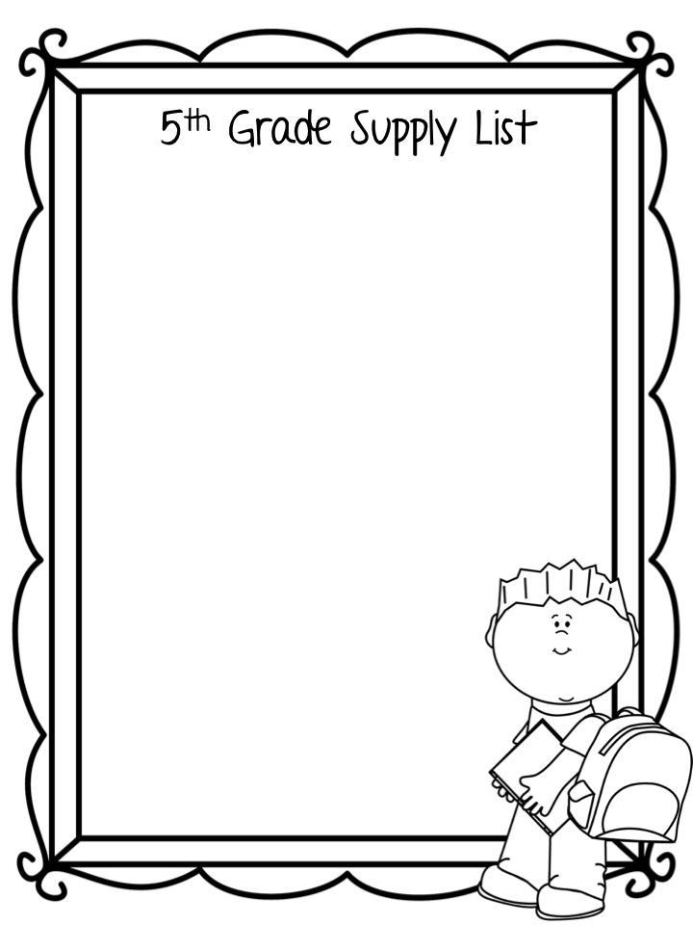
1- Webster’s Dictionary
2- Dozen sharpened No. 2 pencils
2- Red Pens
2- Boxes of tissues
1- Package of filler paper wide rule
4- Blue or black ink pens
1- Pack of different color highlighters
7- Marble Composition books
1- 24 count Crayola crayons
1- box Crayola colored pencils
1- 8 count Crayola Original Formula Markers
1- 5" pointed Fiskars Scissors
1- pack of 3 x 5 Index Cards - ruled 100 count
1- 8 oz. Elmer's Glue or 4 Elmer's glue sticks
1- Sketch Book Wire bound
4- Plastic pocket folders with clasps
2- Containers of Clorox Wipes
1- Protractor
1- Pencil case with zipper
1- Binder- 1 inch
1- Package of sheet protectors
1- bottle of hand sanitizer
1- set of Rosary Beads
1- set of headphones

Slide 9
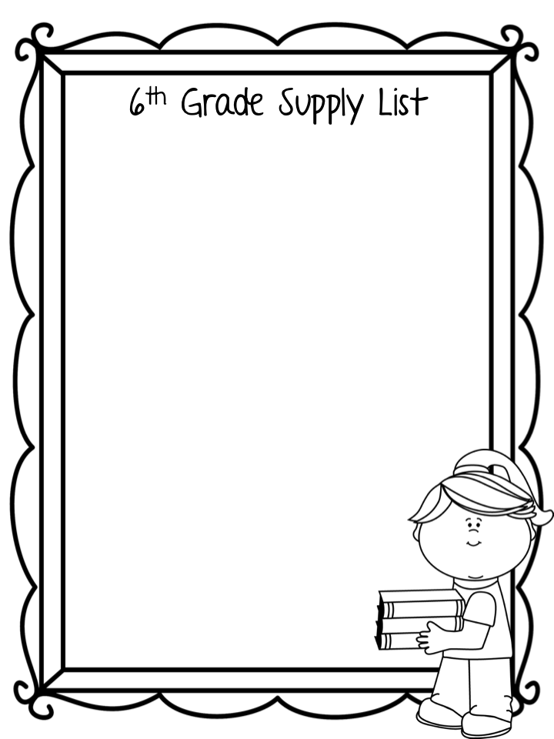
1- Pack of Blue Pens
1- Pack of Black Pens
1- Pack Red pens
4 dozen- No. 2 pencils wooden or mechanical
1- Protractor
1- Ruler (inches and centimeters)
2- Basic calculators for Math
1- Hand held pencil sharpener
1- Box of Crayola colored pencils
1- 8 count Crayola Original Formula Markers
3- Glue sticks
1- 5" pointed scissors
1- Large pencil case with zipper
5- Marble Composition books
3- Plastic pocket folders with clasps
2- 1 1/2 ” hard cover binders
2- Sets of dividers with pockets
3- Packages of Filler paper wide rule
1- Spiral Notebook, 3 subject
3- Boxes of Tissues
2- Containers of Clorox Wipes
1- Roll of Paper Towels
2- Reams of white copy paper
1- Sketch book Wire bound
1- Set of Rosary beads
4- Sets of Headphones (earbud style)

